Slide 1
Lecture 2 - Antenna Parameters
Jatinder Singh
Assistant Professor
ECE Department
UIET, PU Chandigarh

Slide 2
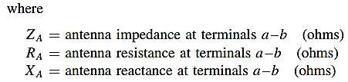
INPUT IMPEDANCE
Defined as the impedance presented by an antenna at its terminals OR
the ratio of the voltage to current at a pair of terminals OR
the ratio of the appropriate components of the electric field to magnetic fields at a point
𝑍_{𝐴} = 𝑅_{𝐴} + 𝑗𝑋_{𝐴}

Slide 3
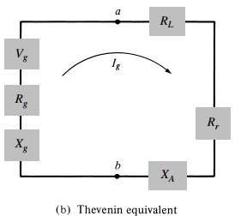
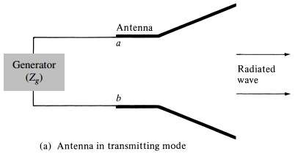
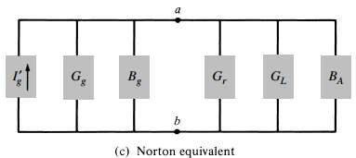

INPUT IMPEDANCE
Transmitting antenna and its equivalent circuit
In general, the resistive part consists of two components
𝑅_{𝐴} = 𝑅_{𝑟} + 𝑅_{𝐿}

Slide 4
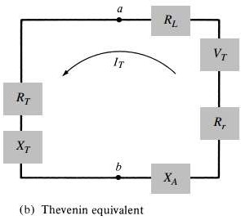
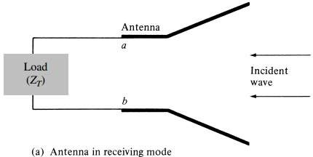
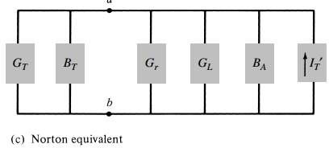
INPUT IMPEDANCE
Antenna and its equivalent circuits in receiving mode

Slide 5
Antenna Impedance
It may be purely resistive, or resistive with a reactive (inductive or capacitive) component.
An antenna is said to be resonant if it displays no reactive component. That is, its impedance is purely resistive.

Slide 6
Antenna Impedance
The resistive portion of the impedance, is made up of a radiation resistance and a loss resistance.
The radiation resistance is an imaginary resistance. The power “dissipated” in this resistance is the power actually radiated from the antenna.
The loss resistance is made up of resistances of the conductors used to make the antenna and other losses in the antenna system. The power dissipated in these resistances is lost, wasted as heat.

Slide 7
Antenna Impedance
The impedance will vary with frequency.
The radiation resistance varies relatively little with frequency, but the reactance varies much more with frequency – capacitive below resonance and inductive above – increasing the SWR either side of resonance.

Slide 8
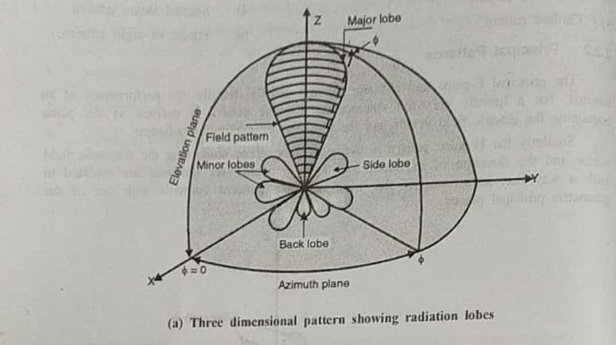
RADIATION PATTERN

Slide 9
Major lobe :
It is the radiation lobe containing the direction of maximum radiation.
Some antennas may have more than one major lobe depending on the application
Minor lobe:
All the lobes except major lobes are called minor lobes. Minor lobes usually
represent radiation in undesired directions and they must be minimized.
Side lobe :
It is a radiation lobe in any direction other than the major lobe, Generally it is
adjacent to the major lobe and occupies the hemisphere in the direction of the major lobe
Side lobes are generally the largest minor lobes.
Back lobe :
It is a minor lobe that occupies the hemisphere in the direction opposite to that
of the major lobe:
The side lobe ratio is expressed as a ratio of the power density in the side lobe
to that of the major lobe, Generally side lobe level of more than - 20 dB are
preferable in most application. (e.g. In radar side lobe ratios must be minimum to avoid
false target indications.)

Slide 10










Radiation Pattern Lobes
Main lobe
Full Null Beamwidth Between
1st NULLS
Side lobes Back lobes

